Slide 1
Introduction to open source

Slide 2

Founder- Eric Steven Raymond (ESR)
Year- 1998
Organization- Open Source Initiative

Slide 3
What is Open Source Software
Open source software is computer software that has a source code available to the general public for use as is or with modifications.
This software typically does not require a license fee.
The key fact that makes open source software (OSS) different from proprietary software is its license.

Slide 4
Is there any difference between Open source software , Freeware, Free software, Shareware?

Slide 5
Freeware: Freeware software’s are available to use with no cost. Source code is not available
Shareware: Shareware software’s are used for marketing purpose. Computer users can download and use a limited version of software or full version of software for a limited period of time. We can say that Shareware software is just like “Try before you buy”.
Free Software: Free software can be used, modified and studied without any restriction. Free software can be copied and distributed with or without any modifications.
Open Source: Open source software can be defined as computer software for which the source code of the software is available under a copyright that must meet the open source definition.

Slide 6
Open Source Software
OSS is unique in that it is always released under a license that has been certified to meet the criteria of the Open Source Definition.
These criteria include the right to:
Redistribute the software without restriction
Access the source code
Modify the source code
Distribute the modified version of the software.

Slide 7
Advantages of OSS
Lower Cost
Flexibility
Reliability and Quality

Slide 8
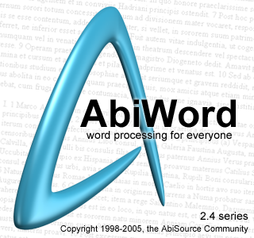




Examples
Office Automation: AbiWord, OpenOffice, KOffice
Web Design: Nvu, GIMPShop Bluefish
Communication: Pidgin Thunderbird, PhpBB
E-commerce: OsCommerce, VirtualMart, Zen Cart
Content-Management System: Drupal Joomla
Operating System: Fedora , Android
Web Browser: Lynx, Mozilla, Firefox
Programming Languages: Perl, PHP, Python, Ruby

